Slide 1
Research on Testing &
FP7 BASTION
CEBE-P6
Artur Jutman

Slide 2
Presentation Outline
A. Jutman CEBE Workshop & IAB, Tallinn, Sept 16, 2013
No Trouble Found
Embedded Instrumentation
Fault Management against Ageing
Test System for LHC at CERN
FP7 BASTION

Slide 3
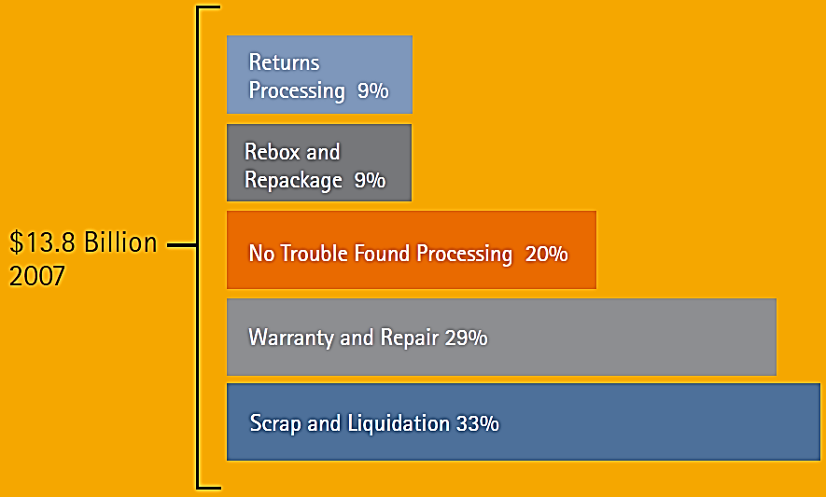
Motivation: No Trouble Found – NTF
NTF symptoms
  System passes all tests in the production
  System fails at the customer
  Troubleshooting cannot repeat the failing condition
70% of all product returns characterized as NTF (US, 2008)
an average family (in US) spends annually 65$ on NTF investigations

Slide 4

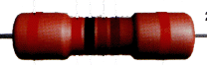
Testability Problem: good old days
PCBA
IC
IC
Simple ICs described by functional/truth tables
Sufficient number of test points

Slide 5
Testability Problem: today
PCBA
BLACK HOLE 1
Defects might be spread among the chips (mismatch)
BLACK HOLE 2
Defects might be hiding inside (behind the horizon)
BLACK HOLE 3
Dynamic defects on the board not covered with functional test
No Trouble Found?

Slide 6
NTF Cause – Dynamic Faults?
Working Hypothesis
  Conclusion: quality of the existing tests is low
  Main hypothesis: good test methodology for dynamic faults is missing
Test Method | Target Faults | Test Access | Diagnostics | Coverage
Structural | Static only | Scan test, JTAG, intrusive | Good | Good but static only
Functional | Dynamic | Functional code + external measurements | No (pass/fail only) | Unknown
Dream | Dynamic | Non-intrusive | Good | Good (static + dynamic)

Slide 7
Existing Test Coverage Metrics
Good quality?
Defect free?
Within parametric tolerances?
How to test?
MPS | PPVS | PCOLA/SOQ
Material | Value | Correct
 |  | Live
Placement | Presence | Presence
 |  | Alignment
 | Polarity | Orientation
Solder | Solder | Short
 |  | Open
 |  | Quality
Live
Might be expensive to guarantee and measure
Quality
Coverage of dynamic faults is missing!

Slide 8
embedded instrumentation
Some Results

Slide 9
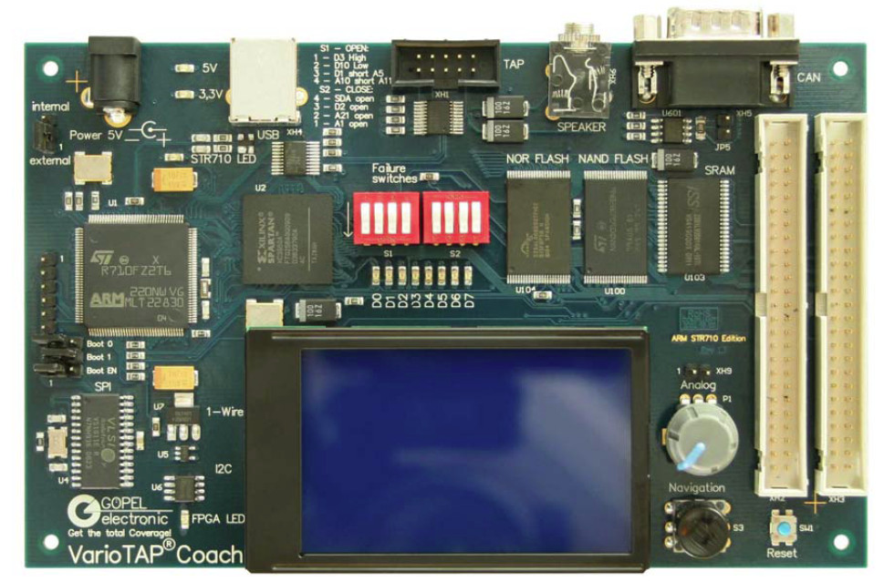
Embedded Instrumentation for Test Access
We assume the system has a JTAG port, and a programmable device
JTAG
FPGA
μP
NOR
FLASH
NAND
FLASH
SRAM
SPI
FLASH
I2C
I/O I/O

Slide 10

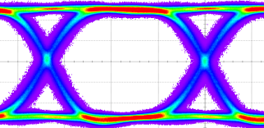


Embedded Instrumentation on FPGA
A new class of instrumentation has been proposed
  Embedded virtual instrumentation (EU+US pat. applications)
  Allows full automation of design, integration, test
Developed instrument examples
  BERT, at-speed test, frequency measurement, etc.
  High-speed in-system programming (flash ICs)
Instruments
External
Embedded
Traditional Virtual Synthetic
Traditional Virtual Synthetic
10

Slide 11
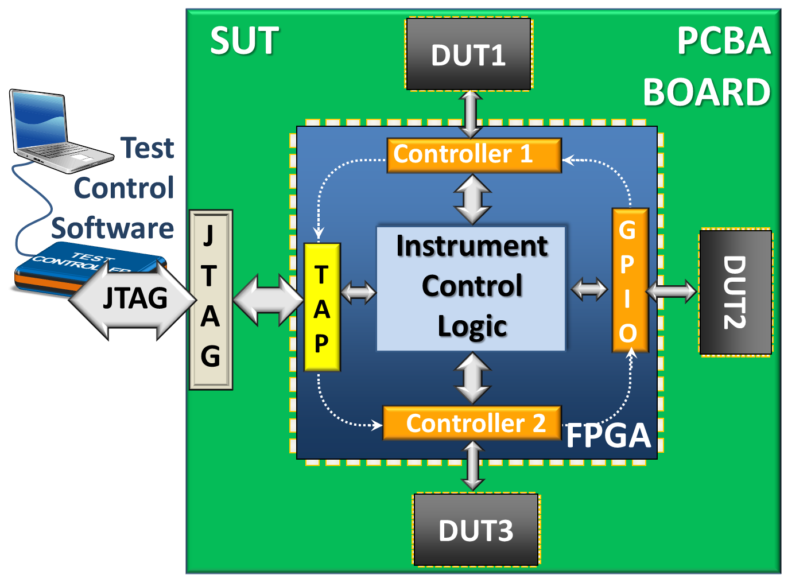
JTAG-controlled FPGA Instruments

Slide 12
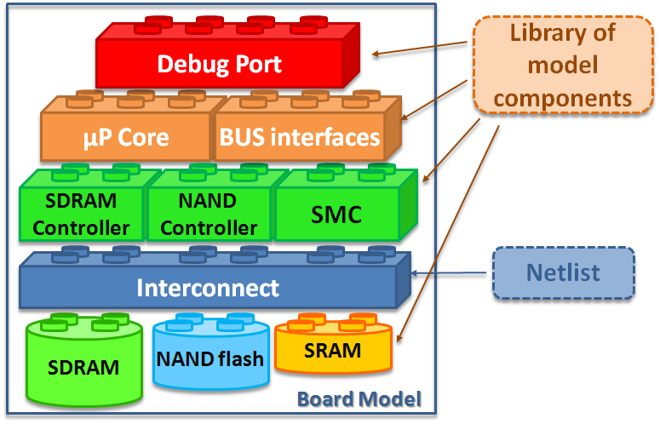
Microprocessor as an Embedded Tester
Represent the system as a set of tightly interrelated models
Components described using Ec-lipse Modeling Framework (EMF)
Use HLDDs at all levels as a traversable uniform model
Use the models to
  Generate testware
  Create a test access path
  Run test and debug routines
Lego-Style System Modeling

Slide 13

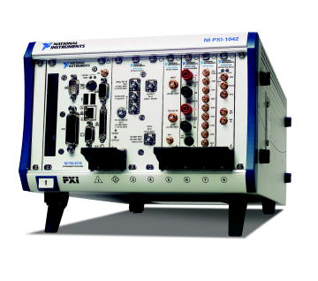

External PC with control software
Customer’s board under test
The test object – Unit Under Test
Part of general purpose IO configured as a Test Bus
System
Under
Test
PCBA BOARD
UUT1
UUT2
Typical general purpose functional tester
Instrument
Card
H
E
A
D
E
R
Embedded Synthetic Instruments
UUT3
FPGA
Programmable IO
Adaptive Test Bus Controller
JTAG standard bus can be used to communicate between the two couterparts
FPGA on the customer board becomes an embbedded tester
FPGA
General purpose IO instrument card from National Instruments
Programmable FPGA on the card becomes an adaptive test bus controller

Slide 14
Achievements and future plans
FPGA instrumentation
  Patent applications + PhD by Igor Aleksejev
  Future: intelligent instrumentation
Microprocessors
  PhD by Anton Tšertov
  Future: test OS + real-time test application
Diagnostic Instrumentation for Functional Test
  Status: initial phase, LabVIEW expertise needed
  PhD student needed

Slide 15
Fault Management against Ageing

Slide 16
A Fault Tolerant System
Interrupts
OS + Scheduler
Activity Map
System
Bus
Reso-
urce 1
Reso-
urce 2
Reso-
urce N
…
BIST/BISD, DFT, Fault tolerance machanisms

Slide 17
FM: Going Beyond the Correction
Fault detection and recovery/correction is NOT enough
Fault Management (FM) provides co-operation between Fault Tolerance and Resource Management
Failure Resilience = Fault Tolerance + Fault Management + Resource Management
Both online and partly offline (core-wise) procedures combined
Fault
Tolerance
Fault Detection
Data Recovery/ Rollback
Fault
Manage-
ment
Fault Diagnosis/ Classification
Statistics Collection
Core/Module Isolation
Resource Health Map
(for Resource Management)

Slide 18
Fault Management Infrastructure
Fault Manager
System Health Map
JTAG
Board Header
OS + Scheduler
Interrupts
Instrument Manager (IM)
Resource Manager (RM)
DATA
MUX
TAP
P1687
Activity Map
F
C
X
System
Bus
Reso-
urce 1
Reso-
urce 2
Reso-
urce N
Minimal
top-level architecture
…
SIB
Status register:
failure, corrected, inactive
F
C
X
Instrument
sub-chains
SIB - Select Instrument Bit

Slide 19
Logarithmic Scaling

Slide 20
Achievements and future plans
Status
  IEEE Design and Test journal paper
  PhD thesis under preparation
  Future: experimental FPGA/ASIC, optimization for target application profiles

Slide 21
Test System for LHC at CERN
BER Test equipment for the communication channel of CMS

Slide 22
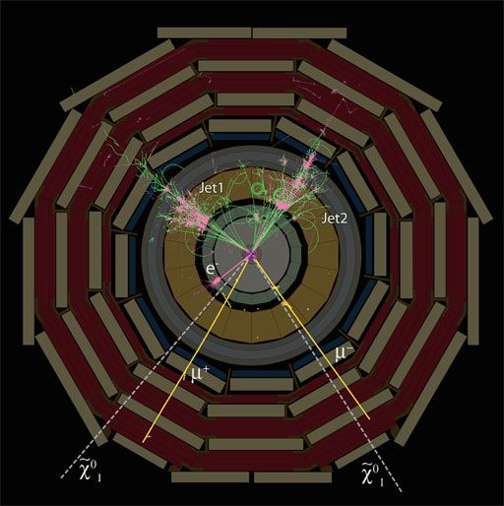
Communication Channel Under Test
Compact Muon Solenoid
(CMS)
On-detector electronics (CMS)
Signal translation boards
Data acquisition system
ROS
TSC
Copper twisted pairs
Optical Fiber
Copper twisted pairs
CMS → ROS: 240 Mbps
CMS → TSC: 480 Mbps
ROS – Read Out Server
TSC – Trigger Sector Collector
Source: http://cms.web.cern.ch/news/how-cms-detects-particles

Slide 23
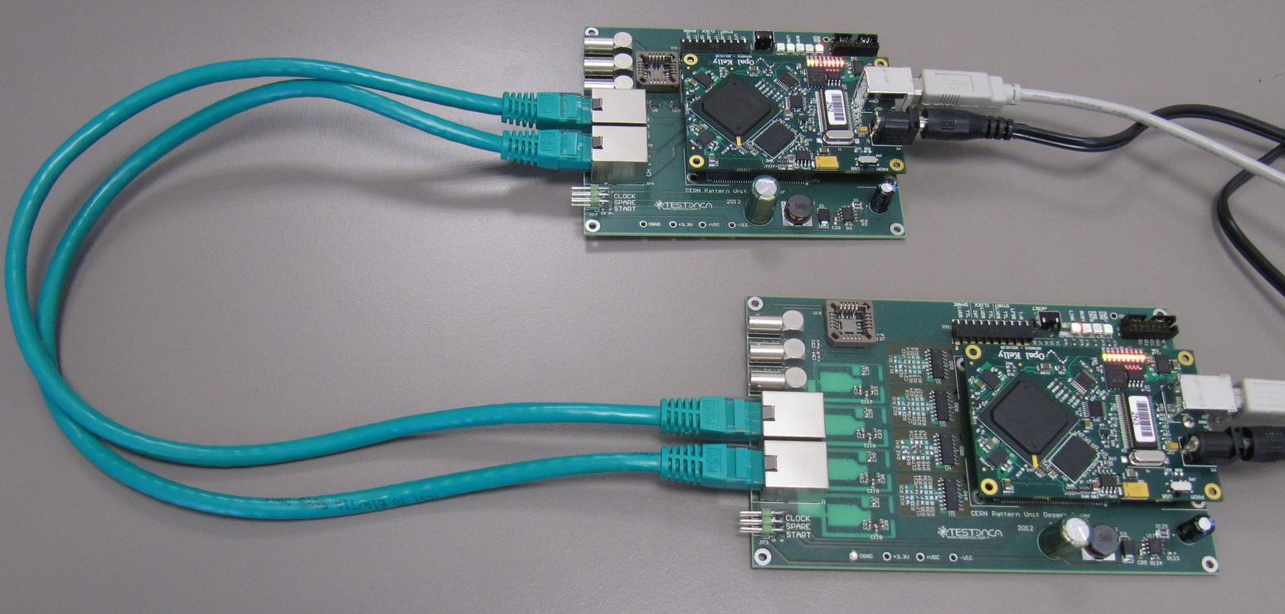
Developed BER Test Equipment
Channel under test
Transmitter and test generator
NB! Real channel:
Copper twisted pairs: 40m
Optical Fiber: 60m
Receiver and BER counter
BER Test algorithms – developed by CEBE engineers
Hardware design and implementation – Testonica Lab + ELIKO
Software and final integration – Testonica Lab
BER – Bit Error Rate

Slide 24
FP7 BASTION
Board and SoC Test Instrumentation for Ageing and No Failure Found

Slide 25
Focus Targets of BASTION
The 2012 ITRS lists ageing (NBTI, PBTI, HCI, etc.) in semiconductor devices as one of the few most difficult challenges of process integration that affects reliability.
NFF is being increasingly reported by industry and according to Accenture Report, in 2008 in US, around 70% of all product returns were characterized as NFF. Cost-wise (including returns processing, scrap and liquidation), NFF amounted up to 50% of total 13.8 billion USD (10.5 billion EUR) returns and repairs cost in US, which approximates to 25 USD (19 EUR) per year per capita.

Slide 26
BASTION:Research Targets and Outcomes
Key Focus: Ageing
Research targets from Call 11:
decreased reliability;
ageing effects;
heterogeneous SOC integration
Application Domain
Basic Technology
WP3: Hierarchical in-field ageing test and monitoring
Key Focus: No Failure Found
Research targets from Call 11:
modeling for new materials,
processes and devices;
system modeling and simulation
WP1: Fault characterization and test coverage metrics
Graceful degra-dation of SoCs
Mainly chip-level, in-field test, and monitoring
WP2: Embedded instrumentation networks
WP4: Instrument-Assisted Testing
for NFF
Reduction of
NFF impact
Mainly board-level, manufacturing test

Slide 27
BASTION Consortium Composition
Project results exploitation value chain:
partners, technologies, tools
Universities
Hamm-Lippstadt
Lund
Tallinn
Torino
Twente
Tool Vendors
End Users
Testonica Lab
Infineon
ASTER Technologies

Slide 28
Thank you!

