Slide 1



Tallinn, Estonia
Sergei Kostin, Ph.D.
Department of Computer Systems

Slide 2

Sergei Kostin (CV)
Education: Tallinn University of Technology
2007–2012 Ph.D. study, Information and Communication Technology,
Ph.D. topic “Self-Diagnosis in Digital Systems”
2006–2007 Master Degree in Computer-and System Engineering, “Fault Diagnosis in the BIST Environment”
2003–2006 Bachelor Degree in Computer-and System Engineering
Career:
2015 – … Research scientist, TTU
2012 – 2015 R&D Engineer, Testonica Lab
2005 – 2011 Development Engineer, TTU
Research topics:
embedded testing and diagnosis of digital circuits
reliability and ageing effects in nanoscale designs

Slide 3

Tallinn University of Technology 2017

Slide 4


Faculties and Departments
Notes:
Among them

Slide 5

TTU campus
Main buildings
Student hostels
Power Engineering
Economics
Library
Notes:
Other buildings are situated a little bit apart in radius half up to one km.

Slide 6

Information technology building
Computer Systems

Slide 7
Research Motivation & Challenges
Lifetime reliability has become one of the key design factors to guarantee CMOS integrated circuit robustness in nanoscale technology
Challenges of technology scaling beyond 65nm: the non-determinism of the devices’ electrical parameters due to time-dependent deviations:
  Hot Carrier Injection (HCI)
  Time-Dependent Dielectric Breakdown(TDDB)
  Electromigration
  Stress voiding
  Interconnect dielectric instability and breakdown
  Negative Bias Temperature Instability (NBTI)

Slide 8
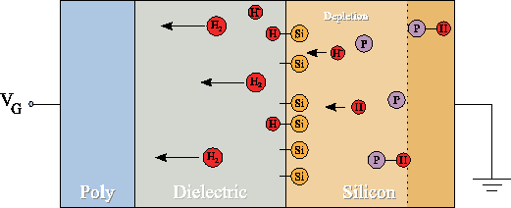
  NBTI Phenomenon
  Negative Bias Temperature Instability (NBTI)
V_{DD}
−V_{DD}
pMOS
V_{DD}
GND
A CMOS invertor gate
Reaction-diffusion model
pMOS transistor is under negatively biased condition
complex temperature-dependent physical/chemical process
  causes a degradation of the oxide
  results in a drift of the threshold voltage (∆Vth)
up to 5-15% transistor performance degradation per year

Slide 9
Reaction-diffusion model
The illustration of NBTI stress and recovery phases
In case of sufficient recovery phases, the aging process may be slowed down considerably compared to the static NBTI effect.

Slide 10
  NBTI effect modeling
  model dependency of pMOS transistor threshold voltage V_{THp} shift on input signal probability P_{z}
W. Wang, et. al, “The Impact of NBTI Effect on Combinational Circuit:Modeling, Simulation, and Analysis”, 2010
Yu Cao, et. al "Cross-Layer Modeling and Simulation of Circuit Reliability“, 2014
PTM 65nm technology
T = 105 ºC
Vth = 1.1V
10 years of aging
These voltage shift values serve as input values for modeling the NBTI-induced gate delays in SPICE simulations.

Slide 11
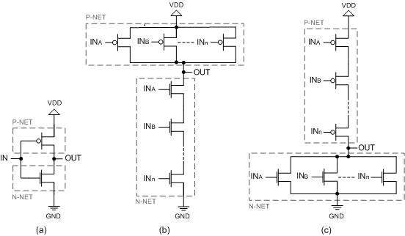
SPICE simulation of basic gates
Transistor level
Inverter
n-NAND
n-NOR
Dependence of gate output delay on ∆V_{THp}

Slide 12
NBTI-induced gate delay degradation modelling
As the result of simulations of individual gates in SPICE a mathematically convenient function (black dash) is matched to each curve characterized with SPICE (blue)
  Δt_{gate}= λ·∆V_{THp}(x_{i})+μ·∆V_{THp}(x_{i})²
list of λ and μ values is extracted and used to precisely model NBTI-induced path delay degradations

Slide 13
De-synchronization due to NBTI
occurs when the sum of all gate delays along a given path is larger than the time slack
Time slack
Propagation along path P₀ at the start of the circuit lifetime
Propagation along path P₀ in 10 years
?
NBTI induced delay in 10 years
Task: Identify NBTI-induced delay critical paths

Slide 14
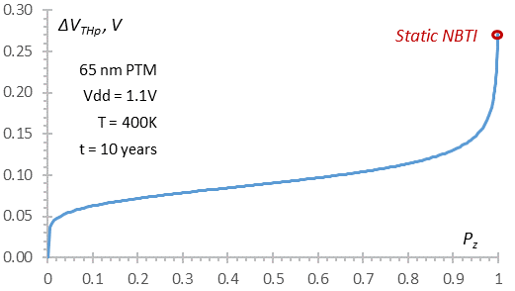
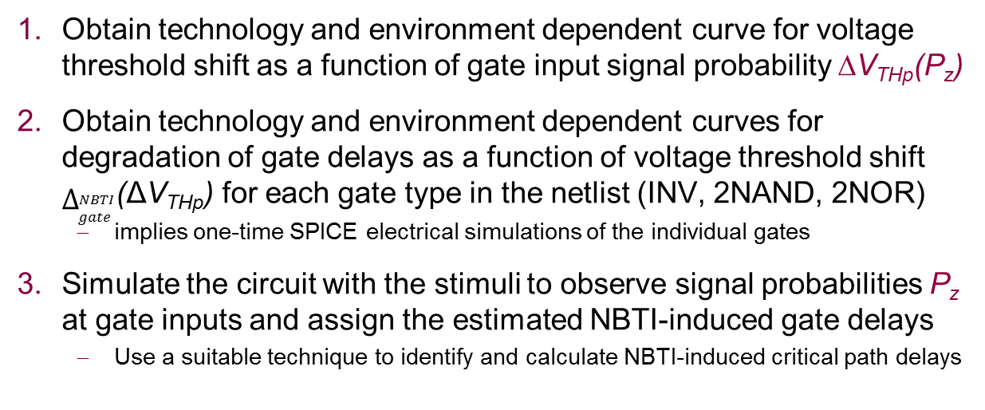

NBTI-critical paths identification flow
Obtain technology and environment dependent curve for voltage threshold shift as a function of gate input signal probability ∆V_{THp}(P_{z})
Obtain technology and environment dependent curves for degradation of gate delays as a function of voltage threshold shift $Δ_{gate}^{NBTI}$(ΔV_{THp}) for each gate type in the netlist (INV, 2NAND, 2NOR)
  implies one-time SPICE electrical simulations of the individual gates
Simulate the circuit with the stimuli to observe signal probabilities P_{z} at gate inputs and assign the estimated NBTI-induced gate delays
  Use a suitable technique to identify and calculate NBTI-induced critical path delays
Step 1: ∆V_{THp}(P_{z})
Step 2: $Δ_{gate}^{NBTI}$(ΔV_{THp})

Slide 15
Static NBTI-critical path delay calculation
Primary Inputs
2
G₃
6
Primary Outputs
2
3
G₁
4
2
τ (G_{k,1})
2
5
1
8
d(G_{k})
1
G₅
9
1
G₆
3
2
G₁₀
G_{k}
2
3
10
8
1
2
G₈
2
τ (G_{k,2})
G₂
6
6
1
G₇
1
G₁₁
2
3
2
G₉
d(G_{k}) – nominal gate output delay
τ (G_{k,i}) – delay increase by NBTI
t(G_{k,i})) = τ (G_{k,i}) + d(G_{k})
3
5
9
G₄
1
2
Algorithm 1.
NBTI-aware static timing analysis
FOR all gates G_{k}, k = 1, 2, …, NG:
t’(G_{k,i})=$\left\{\begin{aligned}t(G_{k,i}), &x_{i}=0 \\ d(G_{k}), &x_{i}≠0\end{aligned}\right.$
D(G_{k}) = max {D(G_{i})+ t’(G_{k,i})⏐G_{i} ∈ IN(G_{k})}
END FOR
No | G_{k} | G₁ | G₂ | G₃ | G₄ | G₅ | G₆ | G₇ | G₈ | G₉ | G₁₀ | G₁₁
1 | D | 6 | 10 | 15 | 18 | 22 | 28 | 29 | 41 | 34 | 51 | 49
D(G_{k}) = max {D(G_{i})+ t(G_{k,i}))⏐G_{i} ∈ IN(G_{k})}

Slide 16
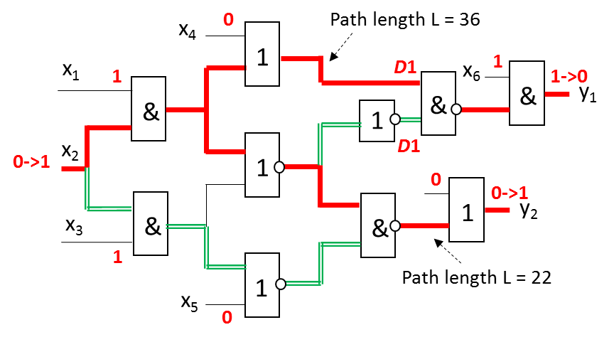
True critical path terminology
The path is critical when the signal propagation time along it through the circuit is longest compared to the one of any other path
The critical path must be true (functional)
  must exist an input vector pair allowing a transition to actually propagate along the path
length of the path means the time needed for propagating a transition through the path

Slide 17
A rule set for path length calculation
Tracing the sensitized paths and iterative calculation of path lengths gate by gate:
a) single sensitized path through gate
b) several paths with cv, first (fastest) transition taken for calculation
c) several paths with ncv, last (slowest) transition taken
D0
D1
1
x_{v} = cv
…
x_{v} = ncv
…
ncv
…
x_{k}
D0
D1
x_{k}
1
&
x_{k}
D
D
1
&
1
&
D
x_{k,v}
ncv
…
D
…
x_{k,v}
x_{j,v}=cv
1
x_{k,v}
ncv
1
x_{j}
a)
b)
c)
An input to a gate is said to have controlling value (cv) if it determines the value of the gate output regardless of the values on the other inputs, otherwise, non-controlling value (ncv)
Transition notations: 0→1 = D1 and 1→0 = D0

Slide 18
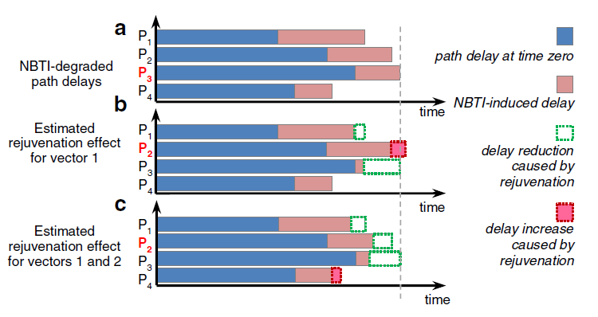
Rejuvenation stimuli impact
An example of rejuvenation stimuli generation

Slide 19
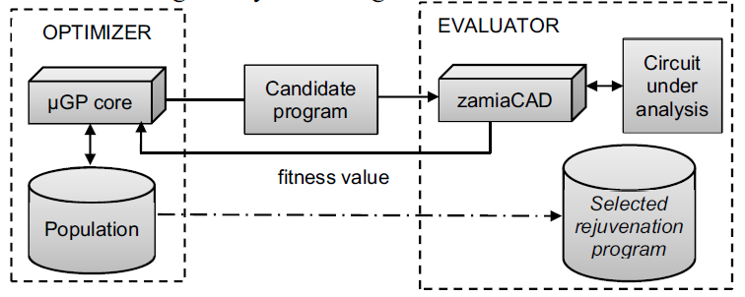
Rejuvenation stimuli generation
An general flow of the evolutionary system
Zamiacad – scalable hardware design and analysis framework
  parser and elaboration engine that supports VHDL designs
  design simulation, static analysis and other applications for debug
µGP – general-purpose evolutionary toolkit
  generates candidate solutions for rejuvenation stimuli

Slide 20
Tasks
Perform experiments with Plasma processor, exercising:
Different real programs (workloads)
  Simple C programs → Assembler → Extract Stimuli
Different architectures: ALU, MULT, Shifter, …
Analyze paths between FFs
Analyze:
footprint of ageing on real functional workloads
Aging-aware program refactoring feasibility

Slide 21
Thank you!
Sergei Kostin
skostin@ati.ttu.ee

